Slide 1

AIR TRAVEL & SAFETY
BhargaVA Gaggainpali
Bellevue University

Slide 2
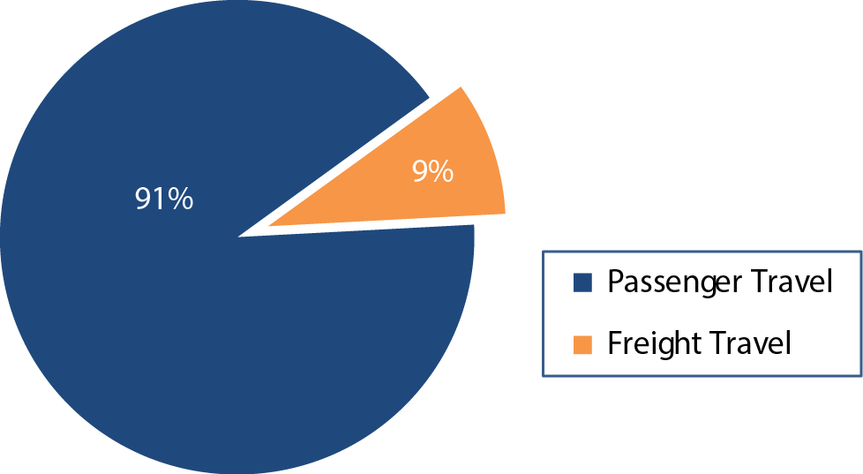

Different modes of Transportation

Slide 3
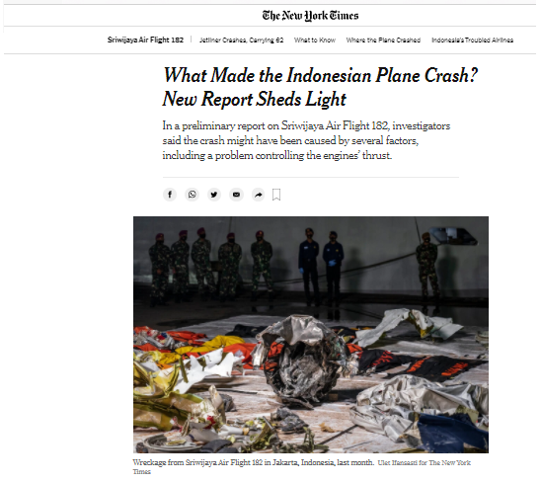
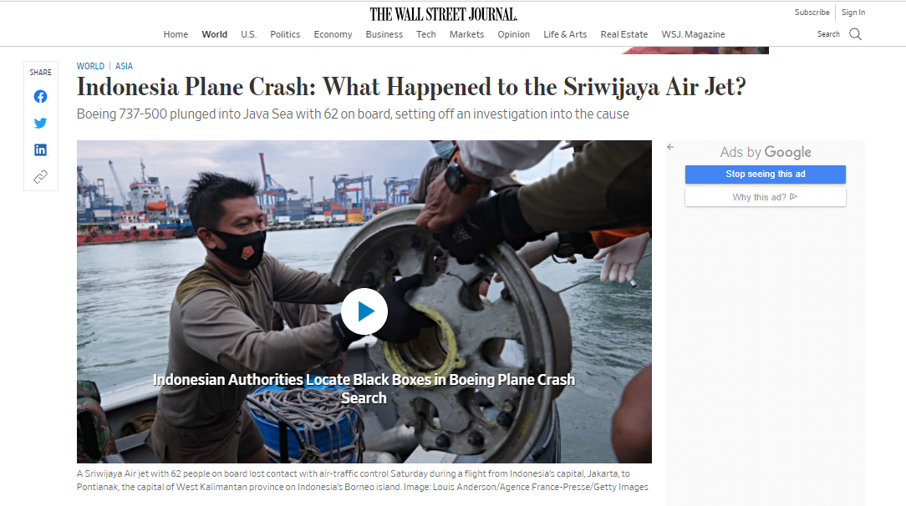
Recent News in
January 2021

Slide 4
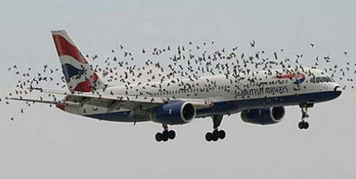
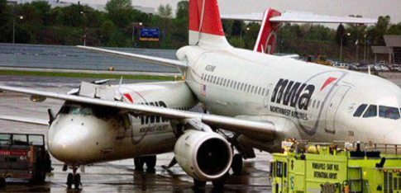
Airline Accidents could happen for many reasons. Implementing safety measures can reduce casualties and fatalities.
Some accidents are caused by unexpected situations.
Some may be caused by human errors.

Slide 5
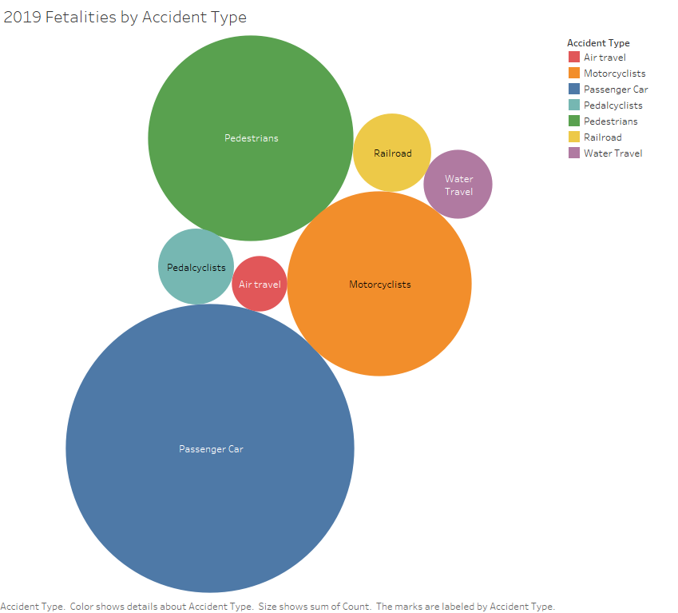
Fatalities by category in the year 2019.

Slide 6
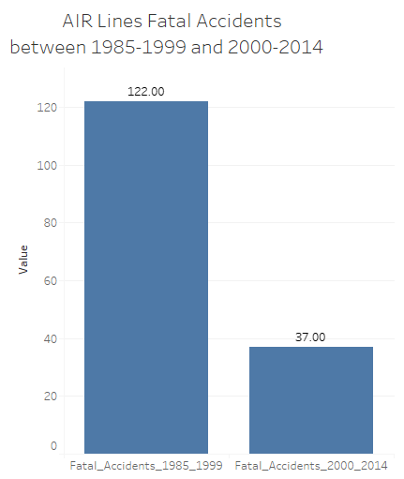
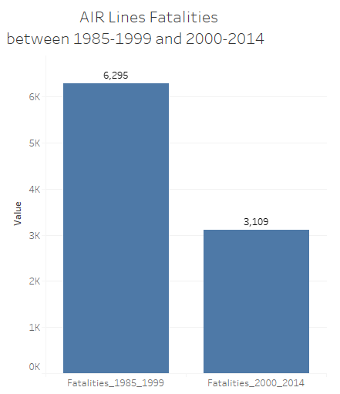
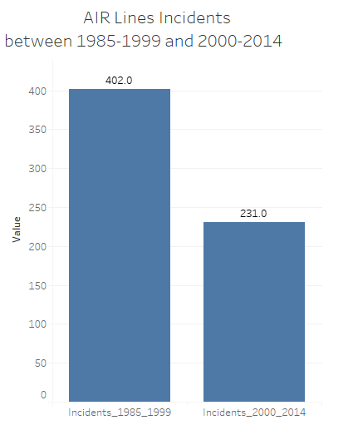
Past 30 years we could see the casualties and fatalities has reduced by significant count by implementing safety measures.

Slide 7
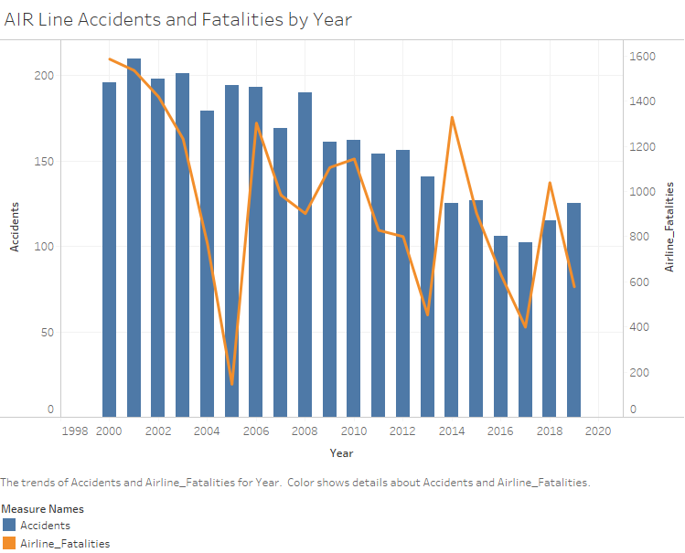
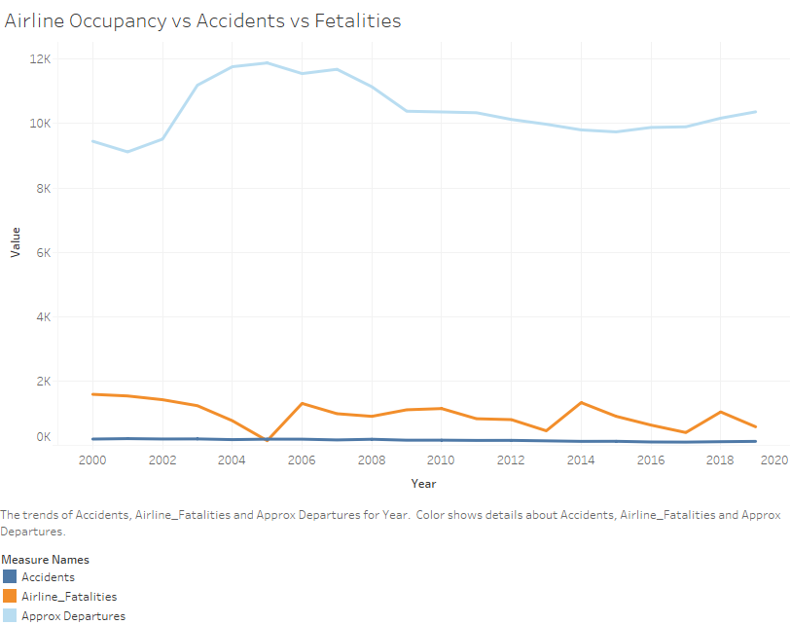
Past 20 years we see Airline occupancy has a steady level where the Accidents have reduced.

Slide 8
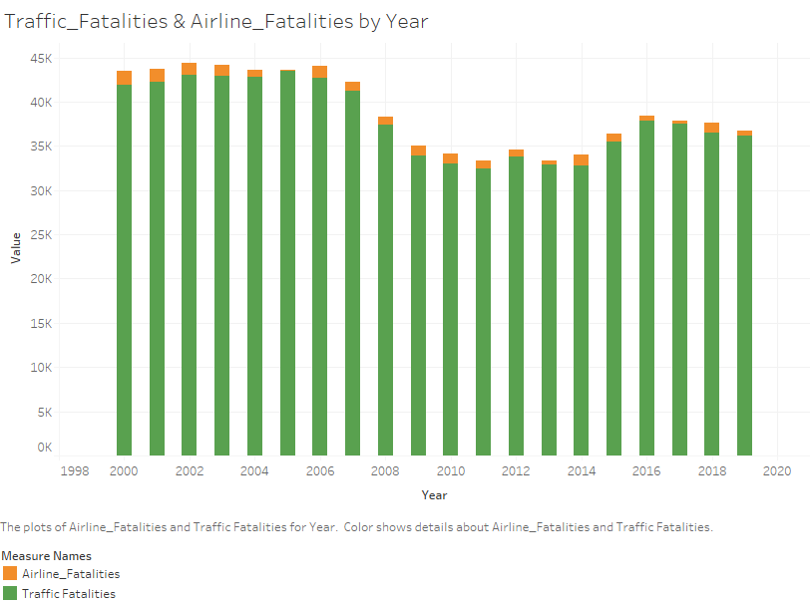
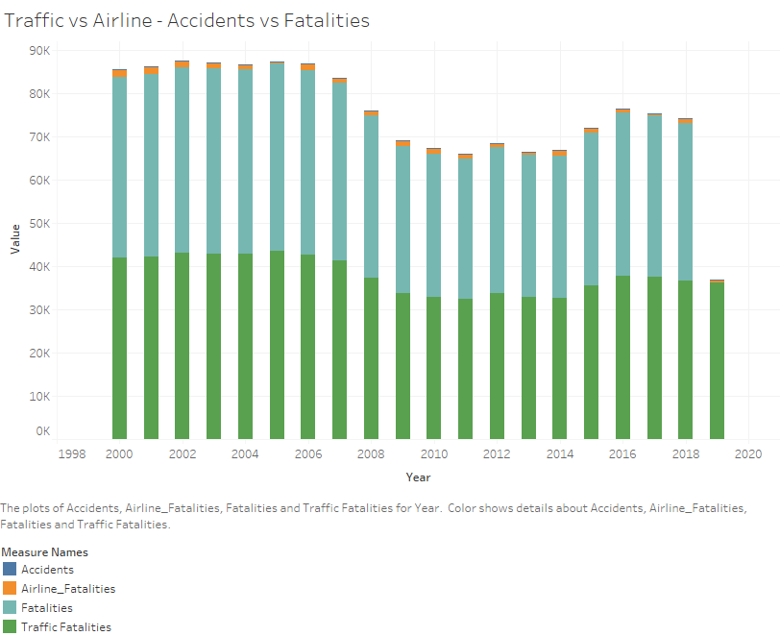
Compared to the Road and traffic accidents, the Airline has a very less count.

Slide 9
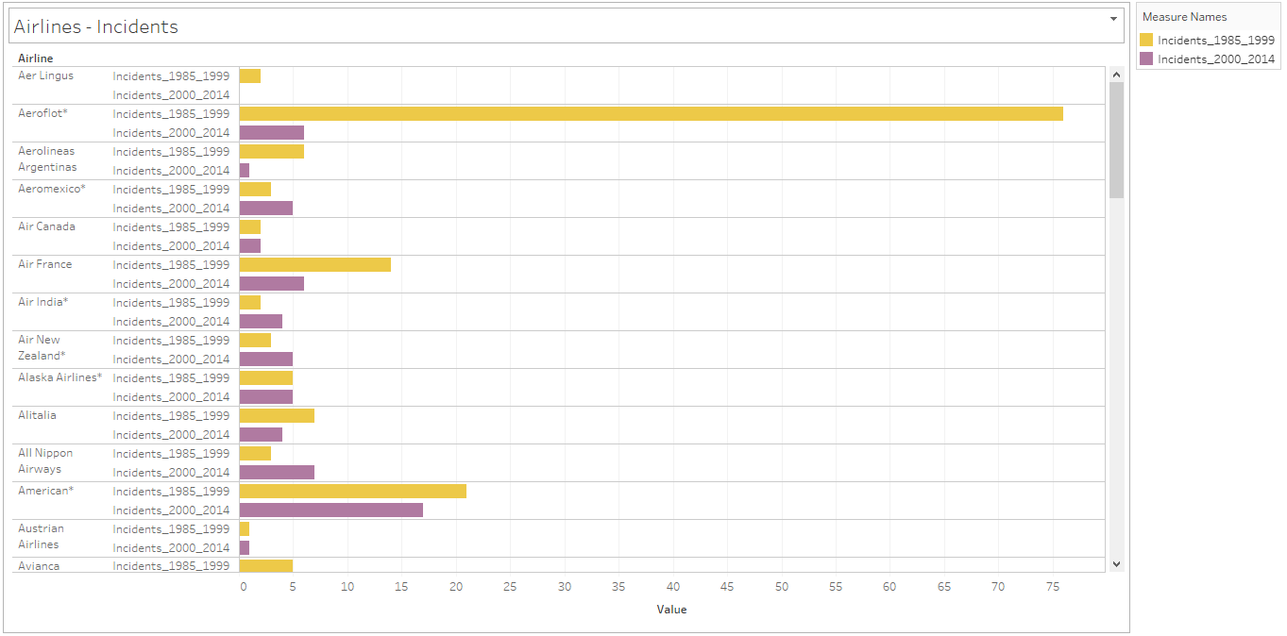
Number of Incidents by Airlines showing the comparison between 1985-1999 vs 2000-2014.

Slide 10
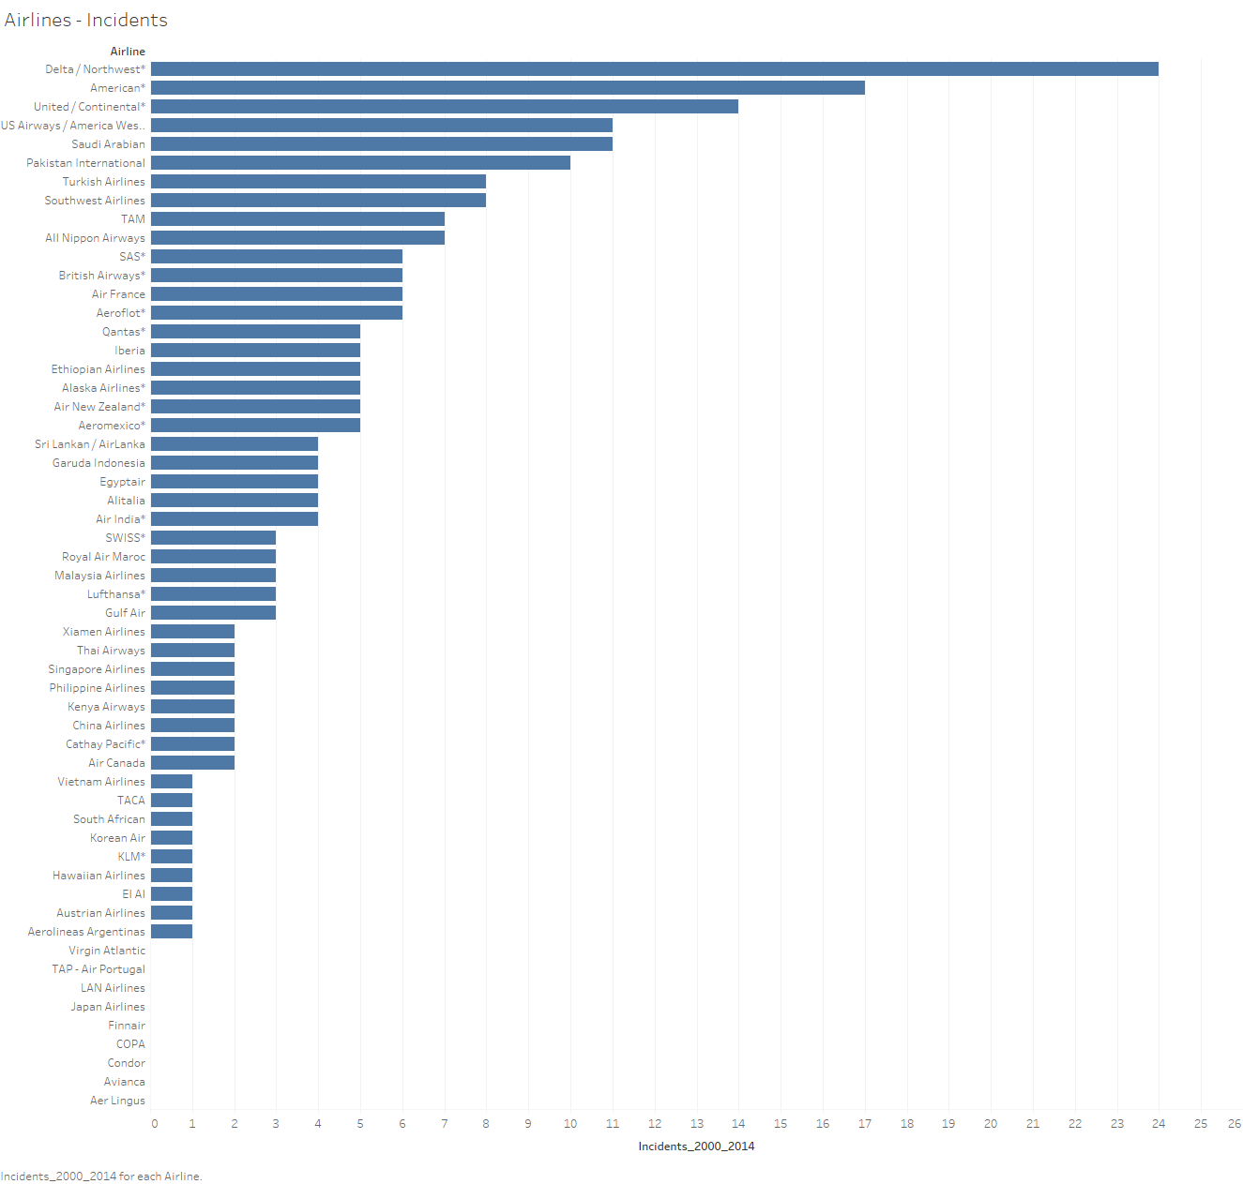
List of the Airlines with the highest to lowest Incidents in the last 15 years.

Slide 11
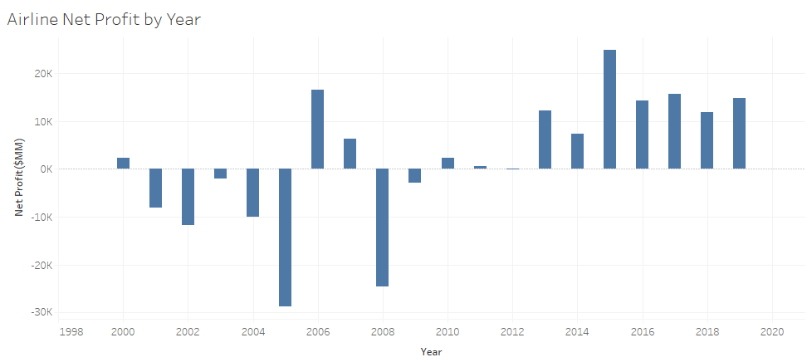
We could see the steady increase of the profits in the recent years show the confidence in the people on the air travel, which could grow in future.

Slide 12
Summary:
Before making any allegations on the overall safety of the airline travel, we need to look at the stats to see how the air travel has increased in volume in terms of number of flights, Air Lines and passengers. This increase in volume gives the confidence of Airline industry for further growth in different places and locations.
As we have seen the stats of how the number of incidents and fatalities has decreased in the recent times compared to last century, shows us the increase of safety measures implemented over the period of time. When compared to the Road Traffic accidents with air travel the percentage is very less. The increase of the net profit of the airline industry over the period of time, shows the confidence in the people to choose to air travel.

Slide 13
Reference:
Airline Safety: https://github.com/fivethirtyeight/data/tree/master/airline-safety
Traffic Fatalities: https://en.wikipedia.org/wiki/Motor_vehicle_fatality_rate_in_U.S._by_year
Net Profit: https://www.airlines.org/dataset/annual-results-u-s-passenger-airlines/#
Airline Accidents: List of accidents and incidents involving commercial aircraft - Wikipedia
Transportation: Transportation Fatalities by Mode | Bureau of Transportation Statistics (bts.gov)
Github repo: bgaggainpali/DSC640_Data_Presentation_And_Visualization (github.com)

Slide 14


